Slide 1
UNIT II Angle Modulation
Dr.M.Manimegalai, ASP, ECE
GCE, Bargur

Slide 2
GENERATION OF WIDEBAND ANGLE-MODULATED SIGNALS
Indirect or Armstrong Method
An important method for generation of a wideband angle-modulated signal is to first generate a narrowband angle-modulated signal using the narrowband angle-modulator and then convert the narrowband signal into a wideband signal.
This method is known as the indirect method of generation of wideband FM and PM signals. It is also known as Armstrong Method.

Slide 3
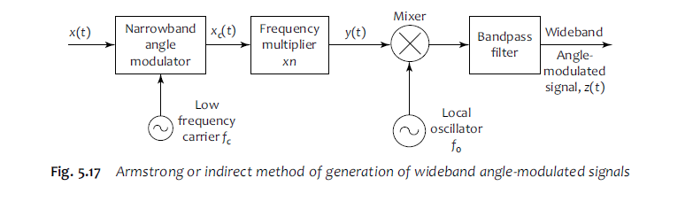
Armstrong or indirect method of generation of wideband angle-modulated signals

Slide 4
The first stage is a narrowband angle modulator. The modulating signal x(t) and a low-frequency carrier signal produced by a crystal oscillator are given as input signals and it uses these two signals to produce a narrowband angle-modulated signal with a carrier frequency of fc. A low-frequency carrier is used for producing the narrowband signal.
The next stage is a frequency multiplier used for converting the narrowband signal into a wideband signal and it raises the carrier frequency from fc to nfc.
The frequency multiplier stage consists of a non-linear device whose output is tuned to the desired harmonic of fc. Generally, a class-C amplifier whose output circuit is a tank circuit tuned to nfc serves as a ‘Xn’ frequency multiplier.
Quite often, this frequency multiplier stage consists of the cascade connection of several doublers and/or triplers.
Although the output signal of the frequency multiplier stage is certainly a wideband angle-modulated signal, the carrier frequency, nfc, of this wideband signal will not in general be the correct desired carrier frequency at which the wideband signal is to be transmitted. Hence, we use a mixer to which we connect the output of a local oscillator having an appropriately chosen frequency f0 and if necessary, a chain of frequency multipliers, in order to finally get a carrier frequency which is the desired carrier frequency.
As the mixer produces the sum frequency and the difference frequency, a bandpass filter which has a centre frequency equal to either the sum frequency, or the difference frequency (whichever is needed) and whose passband is adequate to accommodate the effective bandwidth of the wideband signal, is used.

Slide 5
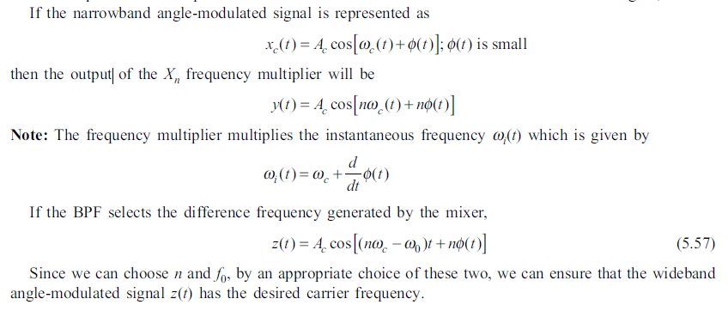

Slide 6
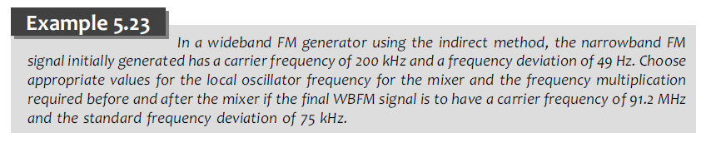

Slide 7
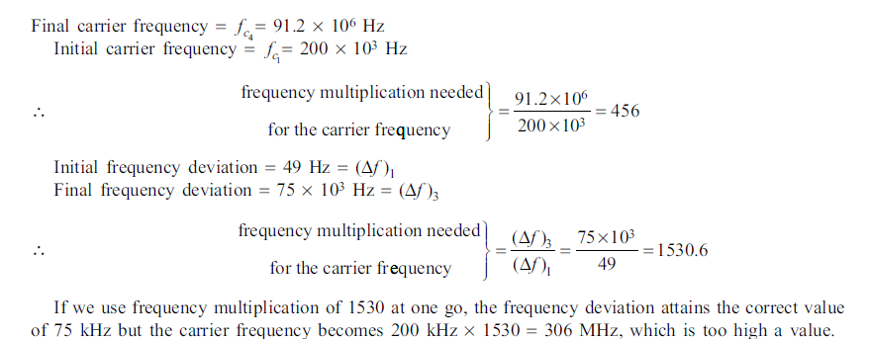
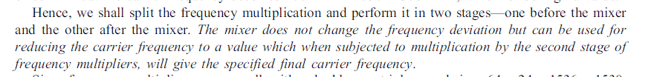

Slide 8
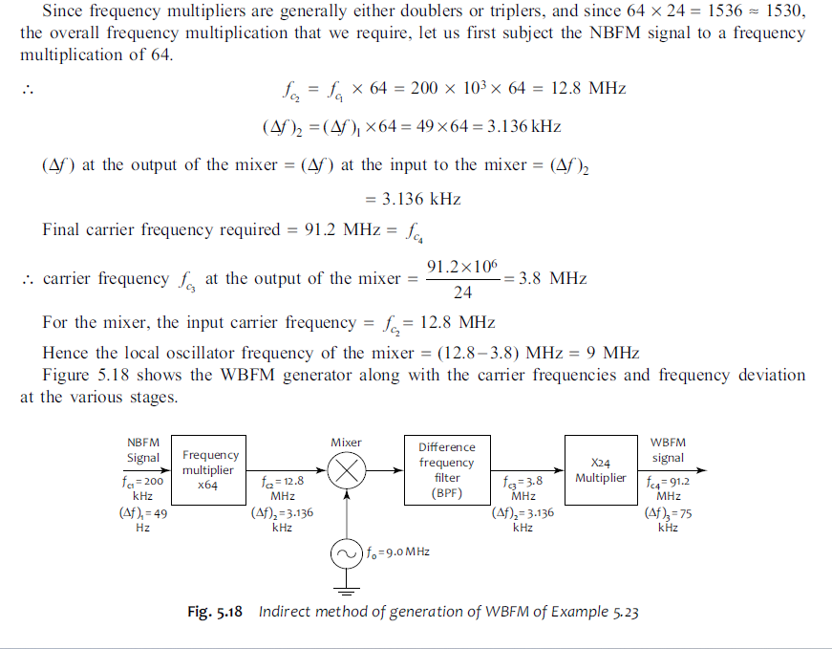

Slide 9
Advantages and Disadvantages of Indirect Method
1. As crystal oscillators are used for obtaining the carrier frequency, it (the carrier frequency) is very stable.
2. Since the narrowband FM is generated by a phase modulator, a long chain of frequency multipliers will have to be used to bring the frequency deviation to the required level.

Slide 10
Direct Method of Generation of WBFM
The basic approach of the direct method is quite simple. Here, we vary the frequency of an L-C oscillator in accordance with the variations in the amplitude of the message or the modulating signal.
This is accomplished by placing an additional reactance across the tank circuit of the oscillator and making this reactance vary with the amplitude of the message.
There are two methods for creating this variable reactance. One is to use a ‘varactor’, or a reactance diode and the other is to use a reactance modulator.

Slide 11
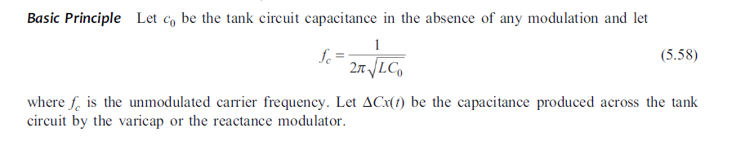

Slide 12
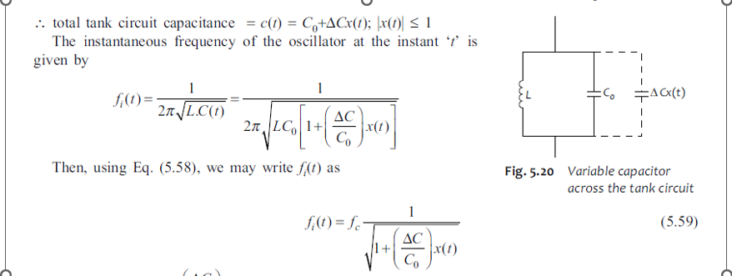

Slide 13
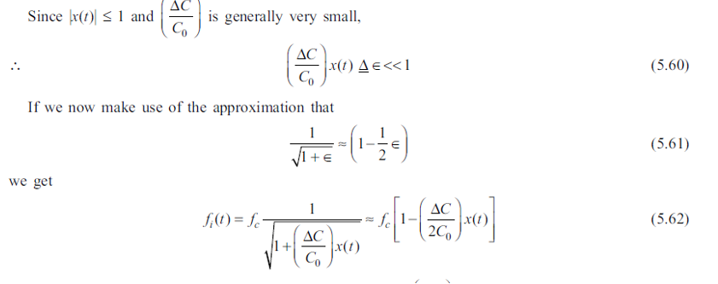

Slide 14
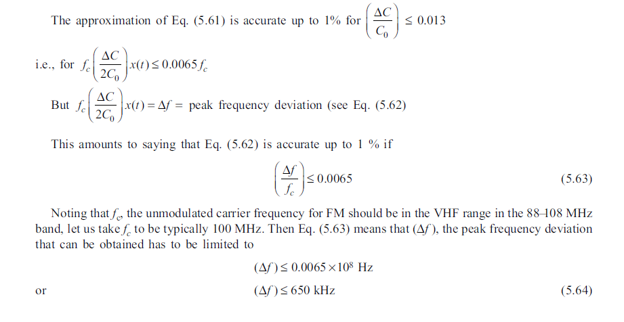

Slide 15
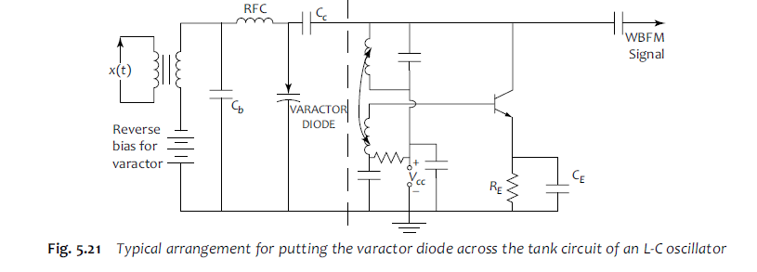
Using a Varactor Diode

Slide 16
The modulating signal x(t) is given in series with the reverse bias for the varactor diode and the diode itself is placed across the tank circuit of an L-C oscillator.
Figure shows a tuned-collector L-C oscillator across whose tank circuit, a varactor diode is connected.
The RFC (RF choke) together with them bypass capacitor Cb ensures that the r.f from the oscillator does not enter the modulating signal circuit.
The coupling condenser, Cc, is of such a small value that it works like a perfect open circuit for the modulating signal frequencies while offering negligible reactance to the r.f signal.
It also prevents the dc bias supply of the varactor from reaching the oscillator.

Slide 17
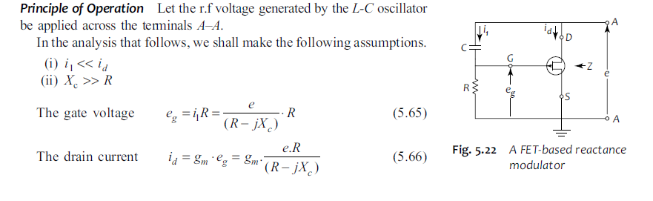
Using a Reactance Modulator

Slide 18
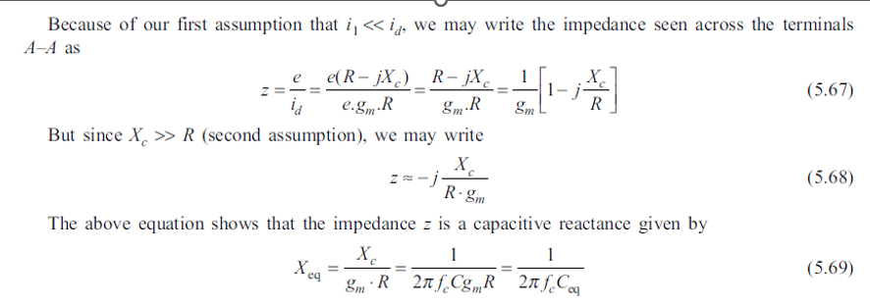

Slide 19
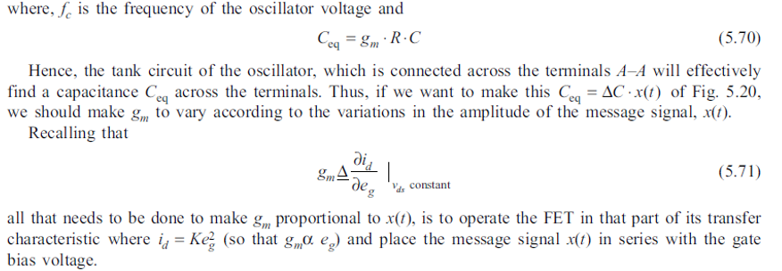

Slide 20
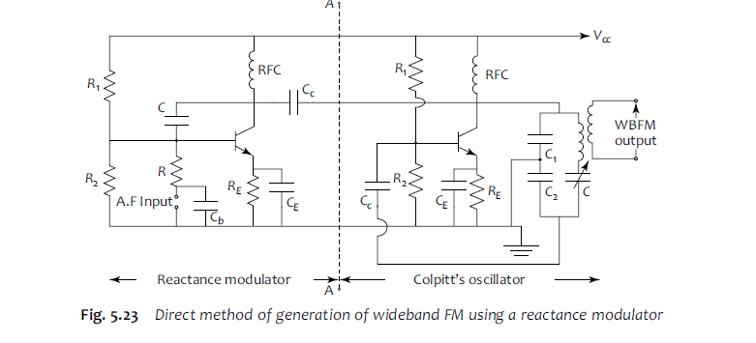

Slide 21
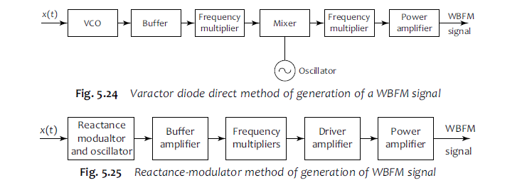

Slide 22
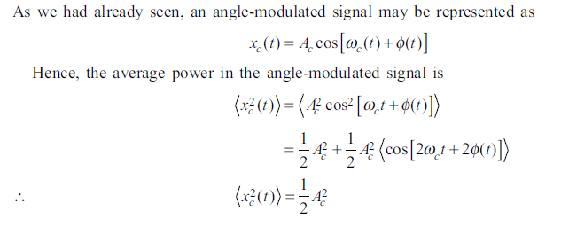
POWER OF AN ANGLE-MODULATED SIGNAL AND EFFECTIVE BANDWIDTH

Slide 23
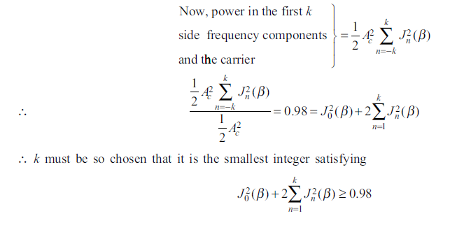
The ‘effective bandwidth’ of an angle-modulated signal as the bandwidth occupied by those minimum number of first k side-frequency components, which along with the carrier component, have at least 98% of the total power of the modulated signal.

Slide 24
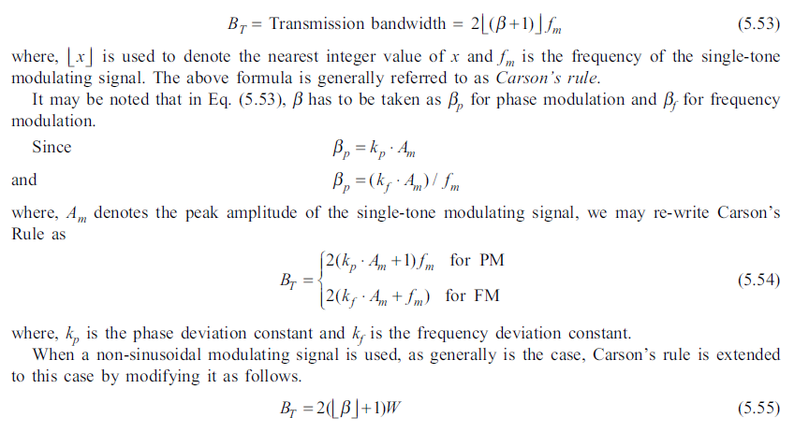

Slide 25
DETECTION OF FM SIGNALS
Since in FM the carrier frequency is changed in accordance with the amplitude of the modulating signal, FM signal demodulation is essentially one of frequency-to-amplitude conversion.
There are several FM demodulators—the slope detector, the phase discriminator of Foster and Seeley, the ratio detector, the FM feedback detector, the quadrature FM detector, the zero-crossing detector and the phase-locked loop detector.

Slide 26
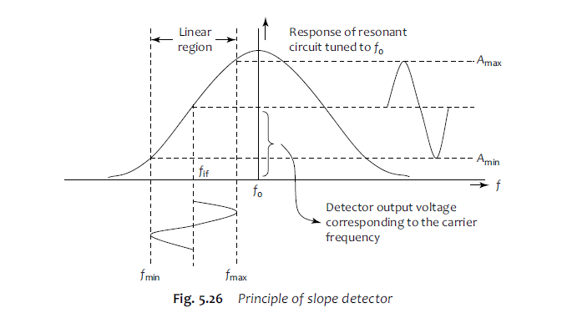
The Slope Detector

Slide 27
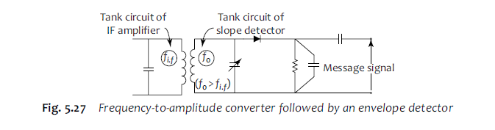

Slide 28
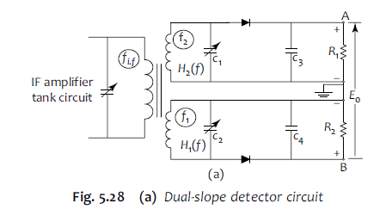
Dual-slope Detector or Balanced Discriminator

Slide 29
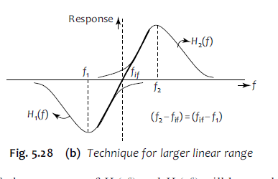

Slide 30
Phase-Locked Loop (PLL) Detector
There exists one disadvantage with all the FM demodulation methods described earlier.
All these methods have the same bandwidth as the bandwidth occupied by the FM signal, which of course, is very much more than the bandwidth of the message signal.
Thus, these demodulators pass on all the noise contained in the bandwidth of the FM signal.

Slide 31
PLL Detector
Using feedback to reduce this bandwidth and thereby reduce the noise power at the output of the demodulator, is one way of tackling the problem.
Such an approach leads to what is known as an FM demodulator with feedback (FMFB).
A demodulator using this approach is the Phase- Locked Loop (PLL).

Slide 32
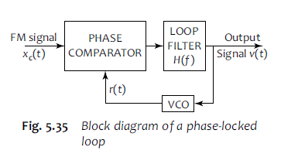
PLL Detector

Slide 33
As can be seen from this figure, it is a feedback system, in fact, a negative feedback system comprising a phase comparator and a loop filter with a VCO in the feedback path. The phase comparator is just a product device. The loop filter has a high gain and a passband from 0 Hz to W Hz.
The VCO is a voltage-controlled oscillator, whose output is a sine wave, the frequency of which is determined by the control voltage given as input to it.
For a mathematical analysis of the system, let us assume that the VCO has been initially so adjusted that
(i) it produces a sine wave with a frequency exactly equal to the unmodulated carrier frequency of the incoming FM signal, when there is no control voltage applied to it; and
(ii) the sine wave signal that it generates under the condition stated above has a 90∞ phase difference with the carrier signal of the incoming FM signal.

Slide 34
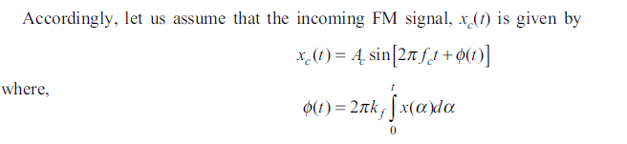
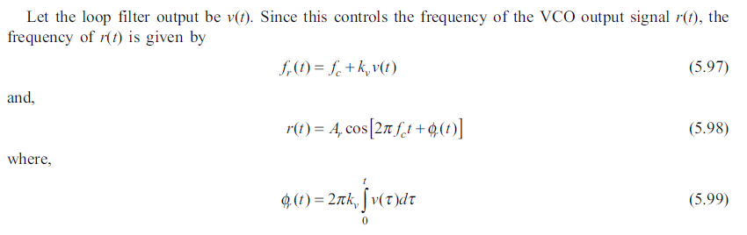

Slide 35
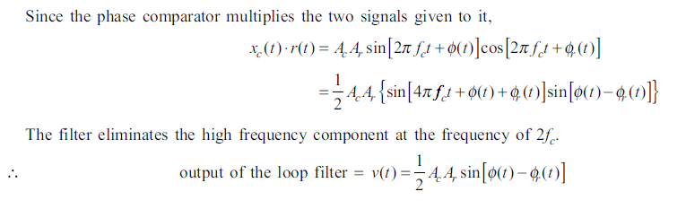

Slide 36
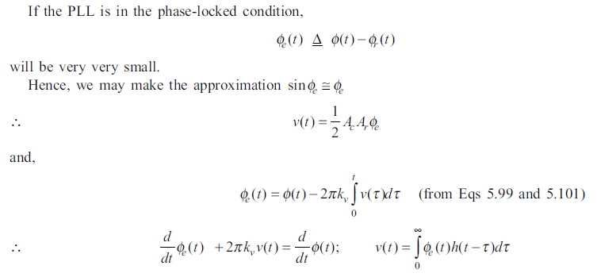

Slide 37
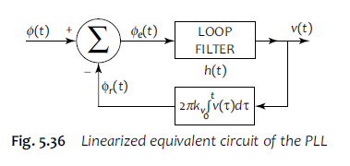

Slide 38
FM BROADCASTING
FM radio broadcasting for speech and music makes use of the 88 MHz–108 MHz band. The peak frequency deviation is to be 75 kHz, audio frequencies up to 15 kHz are handled and the bandwidth is 200 kHz, i.e., two adjacent carriers are to have a separation of 200 kHz.
The transmitters employ pre-emphasis—i.e., boost the high frequency components of the message or baseband signal in order to improve the signal to noise ratio at the destination.
FM broadcast receivers are of the superheterodyne type, the intermediate frequency being 10.7 MHz.

Slide 39
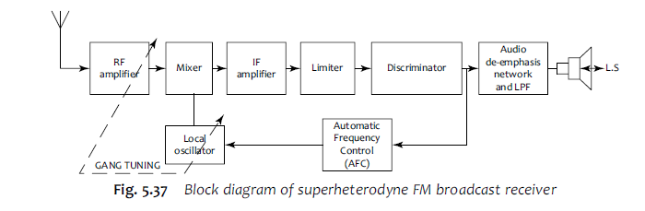

Slide 40
Capture Effect
Suppose there is an interfering signal having a frequency close to the desired signal to which we have tuned the receiver, and that the interfering signal is quite weak compared to the desired signal.
If it were to be AM, in the receiver output, we will be getting not only the desired signal but also the interfering one, the latter as a sort of weak background noise.
But, in the case of FM, the situation will be totally different—only the relatively strong desired signal will be received and the weak interfering signal will be suppressed to a very large extent.
This phenomenon is called capture effect, since the stronger signal virtually captures the receiver.

Slide 41
